Slide 1

Slide 01
Real Time aqi prediction system
Presented by :
Adison Giri (360319)
Hawana Tamang (360325)
Kushal Pathak (360327)
GET STARTED

Slide 2

Slide 02
REAL AQI PREDICTION SYSTEM
Predicts Air Quality Index (AQI) using machine learning. Combines classification and regression for accurate forecasts based on real-world data. Supports public health and environmental decision-making.
About Us

Slide 3

Slide 04
Features
data Sources
Data Visualization
Prediction Model
System scALABILITY
Features

Slide 4

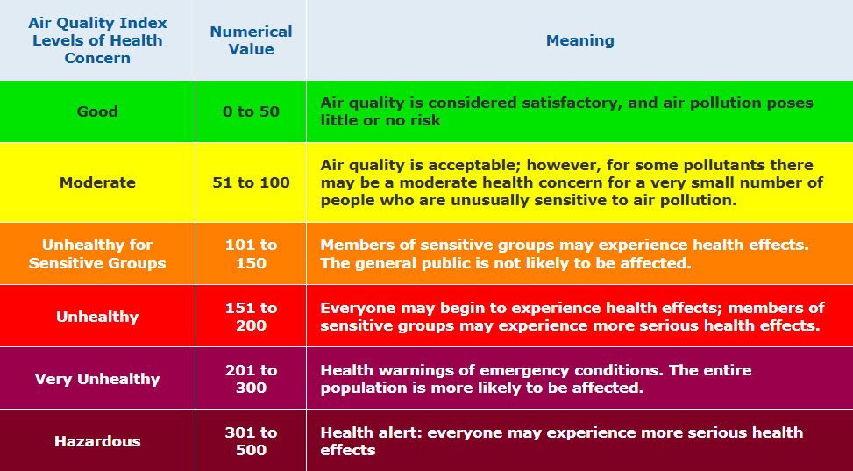

Slide 5
Slide 03
Objective
Provide accurate real-time AQI predictions for various locations.
Integrate multiple data sources, including sensor data and meteorological information.
Implement machine learning models to enhance prediction accuracy.
Develop a user-friendly interface for real-time AQI monitoring and alerts.
Enable data-driven decision-making for public health and safety.
Facilitate continuous system improvement through feedback and model updates.
Support scalability for broader geographical coverage.
Objective
@reallygreatsite

Slide 6

Slide 05
Model
Classification Model
Classification models are a type of machine learning algorithm used to predict categorical outcomes. These models categorize data points into predefined classes or labels.
Model

Slide 7
Slide 06
Model
Regression Model
Regression models are statistical models used to predict a continuous outcome variable based on one or more predictor variables. They are widely used in various fields, including economics, finance, marketing, and social sciences.
Model

Slide 8
Slide 07
Model
Prophet Model
Prophet is a forecasting procedure developed by Facebook's Core Data Science team. It's designed to be fast and provide automated forecasts that can be tuned by data scientists and analysts.
Model

Slide 9

Slide 08
Libraries
numpy
pandas
matplotlib.pyplot
seaborn
RandomForestRegressor
Train_test_split
LabelEncoder
Prophet
Flask
pandas
joblib
prophet
matplotlib.pyplot
io
base64
os
datetime
Libraries

Slide 10
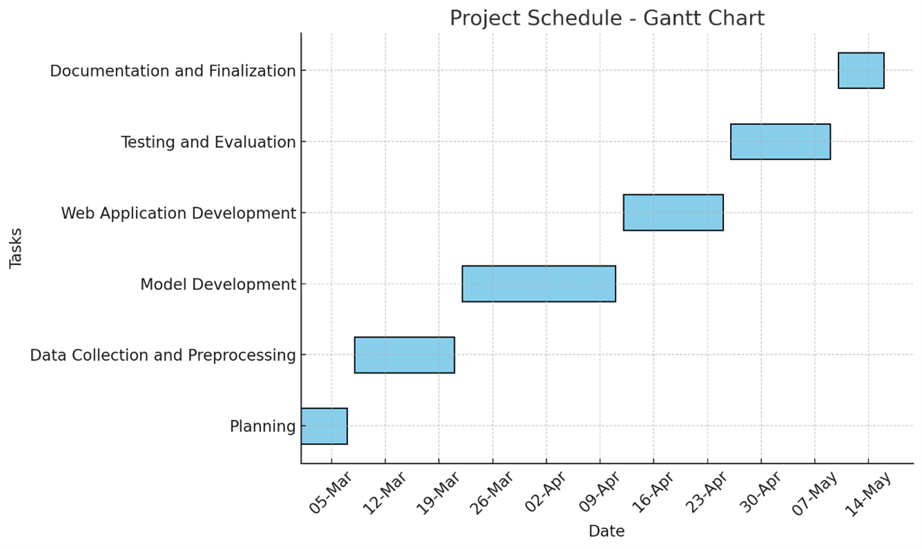
gantt Chart
Slide 09
Gantt Chart

Slide 11
Scope
Slide 10
Geographical Coverage: Focus on urban areas with high pollution levels, with potential expansion to other regions.
Data Sources: Integration of real-time sensor data, historical AQI data, and meteorological information.
Prediction Models: Development and deployment of machine learning models tailored for AQI prediction.
User Interface: Creation of a web-based dashboard and mobile app for real-time AQI monitoring and alerts.
System Scalability: Design the system to handle large volumes of data and support additional features in the future.
Target Audience: Serve individuals, health professionals, policymakers, and environmental agencies.
Scope

Slide 12

Slide 11
Thank You
FOR YOUR ATTENTION
REAL TIME AQI PREDICTION

